Slide 1
Brute Force
Notes:
To create Em dash above headline:
Same size and weight as the headline and set using a soft return.
PC: Em dash (—): Alt+Ctrl+ - (minus)
Mac: Em dash (—): Shift+Alt/Option+hyphen

Slide 2
Agenda
Overview
Sorting
Convex Hull
Exhaustive Search
Sequential Search
Brute Force String Matching
Summary

Slide 3
1. Overview
Notes:
To create Em dash above headline:
Same size and weight as the headline and set using a soft return.
PC: Em dash (—): Alt+Ctrl+ - (minus)
Mac: Em dash (—): Shift+Alt/Option+hyphen

Slide 4
Learning objectives
Understand the Brute Force approach
Understand and apply:
Sorting – Selection and Bubble Sorts
Computational geometry – Convex hull problems
Searching – Exhaustive Search and Sequential Search
String Matching – Brute Force approach

Slide 5
Brute Force
Brute force is a straightforward approach to solving a problem, usually directly based on the problem statement and definitions of the concepts involved.
Examples:
Computing a^{n} (multiply ‘a’ for n times)
Searching for a key of a given value in an unsorted list.

Slide 6
Brute Force
How to get out of a maze (or a dungeon ☺)?
https://www.youtube.com/watch?v=U9Z9HoCY70o

Slide 7
2. Sorting

Slide 8
Sorting
Examples
Sorting Numbers (Sequential)
Telephone book – by surname, e.g., A, B, C, D…
Sorting Books in Library (Dewey system)
Sorting Individuals by Height (Feet and Inches)
Why do we study sorting?
Important to build efficient searching algorithms and data structures, data compression.
Heavily studied problem in computer science, with several widely celebrated algorithms.

Slide 9
Sorting
Formal definition:
Given a sequence of n elements x₁, x₂, … , x_{n} ∈ S
re-arrange the elements according to some ordering criteria.
Example
A = { 3 1 6 2 1 3 4 5 9 0 }
Sorted(A) = { 0 1 1 2 3 3 4 5 6 9 }

Slide 10
Sorting - Details
A process that organizes a collection of data into either ascending or descending order
An internal sort requires that the collection of data fits entirely in the computer’s main memory
We use external sort when the data cannot fit in the computer’s main memory all at once
We will analyze only internal sorting algorithms
Computer output is generally arranged in some sorted order so that it can be interpreted.
An initial sort of the data can significantly enhance the performance of an algorithm.
Majority of programming projects use a sort somewhere, and in many cases, the sorting cost determines the running time
A comparison-based sorting algorithm makes ordering decisions only on the basis of comparisons

Slide 11
Sorting Algorithms
There are many sorting algorithms, such as:
Selection Sort
Insertion Sort
Bubble Sort
Merge Sort
Quick Sort
The first three are the foundations for faster and more efficient algorithms

Slide 12
Brute Force : Selection Sort
Selection Sort is a Brute Force solution to the sorting problem.
Scan all n elements of the array to find the smallest element, and swap it with the first element.
Starting with the second element, scan the remaining n − 1 elements to find the smallest element and swap it with the element in the second position.
Generally, on pass i (0 ≤ i ≤ n − 2), find the smallest element in A[i … n − 1] and swap it with A[i].

Slide 13
Selection Sort
Sorted
Unsorted
23 | 78 | 45 | 8 | 32 | 56
8 | 78 | 45 | 23 | 32 | 56
8 | 23 | 45 | 78 | 32 | 56
8 | 23 | 32 | 78 | 45 | 56
8 | 23 | 32 | 45 | 78 | 56
8 | 23 | 32 | 45 | 56 | 78
Original List
After pass 1
After pass 2
After pass 3
After pass 4
After pass 5

Slide 14
Selection Sort
The list is divided into two sub-lists, sorted and unsorted, which are divided by an imaginary wall
We find the smallest/largest element from the unsorted sub-list and swap it with the element at the beginning of the unsorted data
After each selection and swapping, the imaginary wall between the two sub-lists move one element ahead, increasing the number of sorted elements and decreasing the number of unsorted ones
Each time we move one element from the unsorted sub-list to the sorted sub-list, we say that we have completed a sort pass
A list of n elements requires n-1 passes to rearrange the data

Slide 15
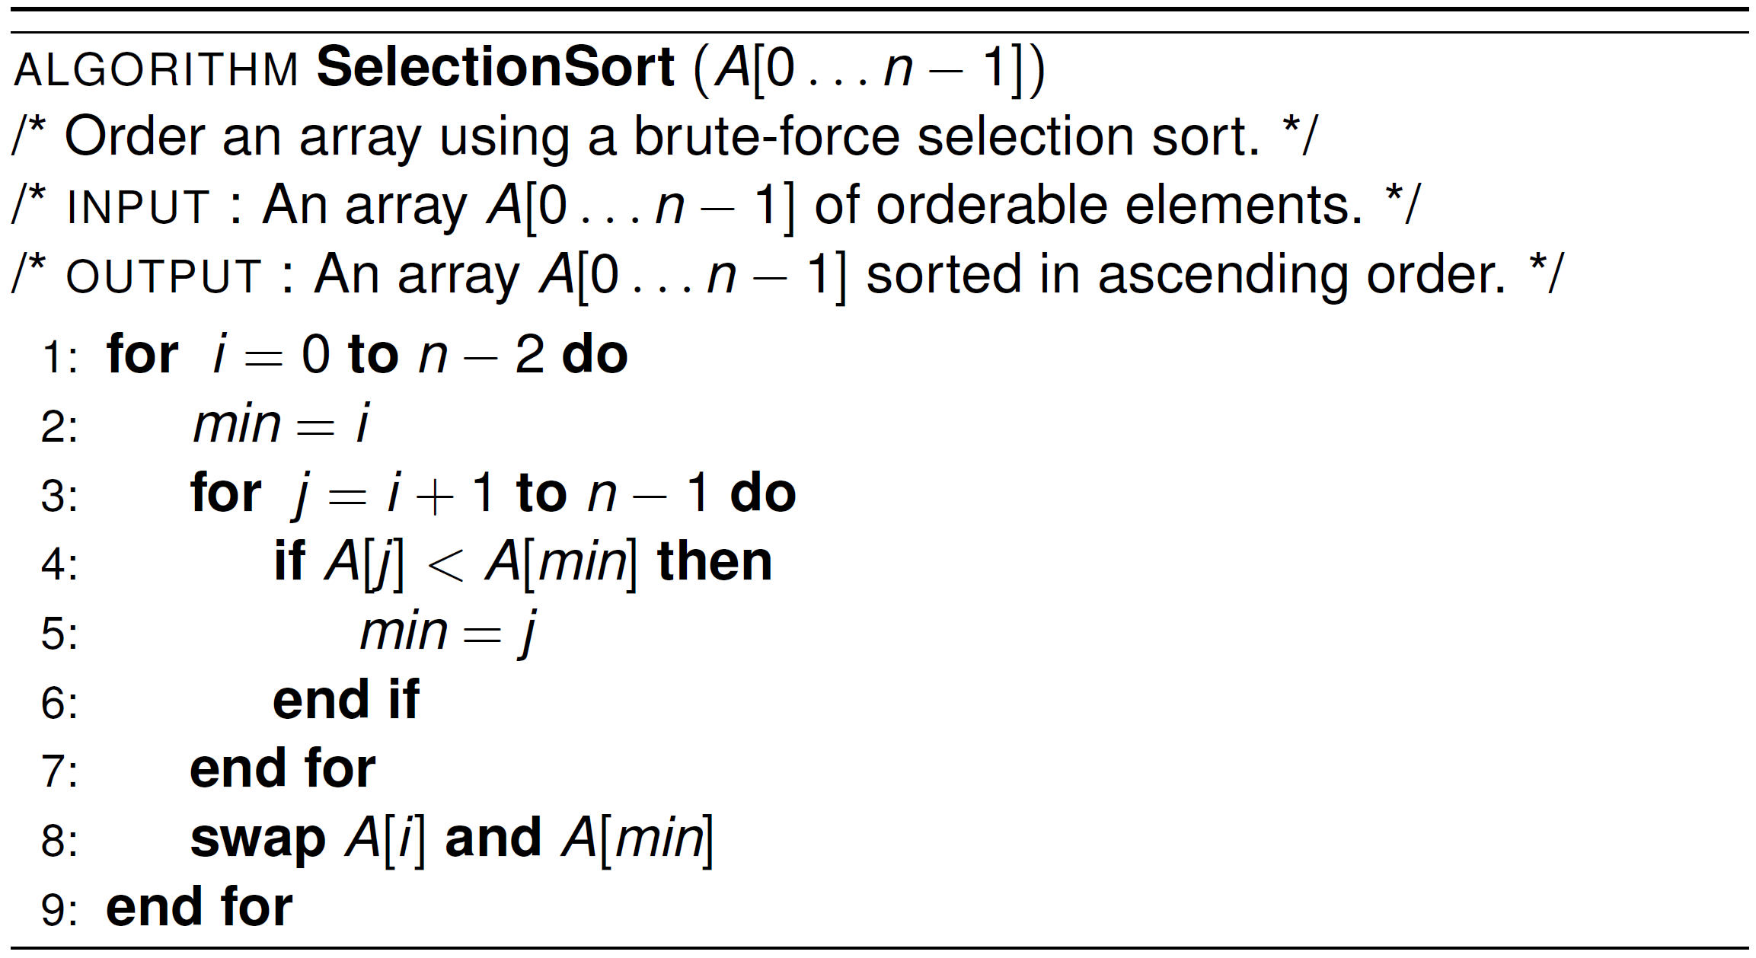
Selection Sort – Pseudocode
No need to sort the last value
Record position
Record position of the new
smallest candidate

Slide 16
Selection Sort - Analysis
In general, we compare keys and move items (or exchange items) in a sorting algorithm (which uses key comparisons)
➔ So, to analyze a sorting algorithm we should count the number of key comparisons and the number of moves
In selection sort, the outer “for” loop executes n-1 times
We invoke swap function once at each iteration
➔ Total Swaps: n-1
➔ Total Moves: 3*(n-1) (Each swap has three moves)

Slide 17
Selection Sort – Analysis (cont.)
The inner for loop executes the size of the unsorted part minus 1 (from 1 to n-1), and in each iteration we make one key comparison.
➔ # of key comparisons = 1+2+...+n-1 = n*(n-1)/2
➔ So, Selection sort is O(n²)
The best case, the worst case, and the average case of the selection sort algorithm are same. ➔ all of them are O(n²)
The behavior of selection sort algorithm does not depend on the initial organization of data
Since O(n²) grows rapidly, selection sort is appropriate only for small n
Although selection sort algorithm requires O(n²) key comparisons, it only requires O(n) moves
Selection sort could be a good choice if data moves are costly but key comparisons are noT

Slide 18
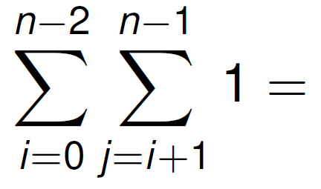
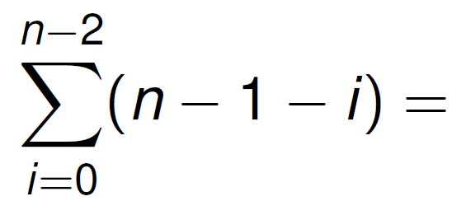
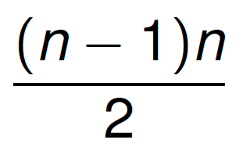
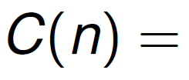
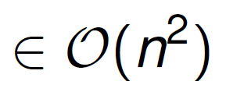
Selection Sort – Time Complexity
Needs around n² / 2 comparisons and at most n − 1 exchanges.
The running time is insensitive to the input, so the best, average, and worst case are essentially the same
Why?
Notes:
Not to mistake insensitive to conditional on input
Regardless of input still need to go through the whole n

Slide 19
Selection Sort – Demo
https://visualgo.net/bn/sorting

Slide 20
Selection Sort – Why use it
Selection sort only makes O(n) writes but O(n²) reads.
When writes (to array) are much more expensive than reads, selection sort may have an advantage, e.g., flash memory.
Also, for small arrays (10 – 20 elements), selection sort is relatively efficient and simple to implement.

Slide 21
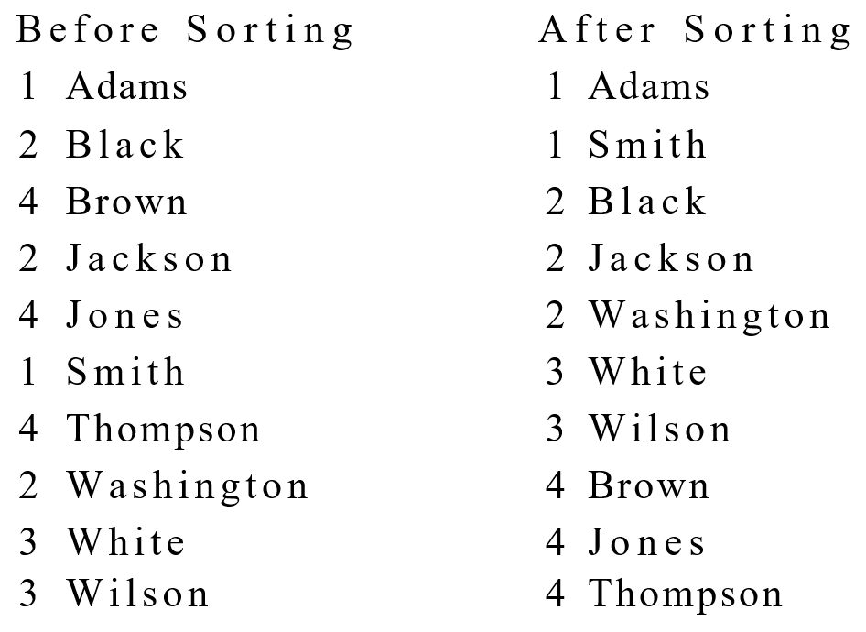
‘Stable’ Sorting Algorithms
A sorting method is stable if it preserves the relative order of duplicate keys in the file.
Why? Think about sorting last names and first names separately
Not all sorting methods are stable.

Slide 22
Is Selection Sort Stable?
Question: is Selection Sort stable?
Consider the following example and apply Selection Sort on them:
5, 5, 3, 2
5, 5, 3, 2
2, 5, 3, 5
2, 3, 5, 5

Slide 23
Another Brute Force sort…
Bubble Sort
A bubble sort iteratively compares adjacent items in a list and swaps them if they are out of order.

Slide 24
Bubble Sort – Motivation
One of the classic (and elementary) sorting algorithms, originally designed and efficient for tape disks, but with random access memory, it doesn’t have much use these days.
But insightful to study it and to understand why other sorting algorithms are superior in one or more aspects.
It is simple to code.

Slide 25
Bubble Sort – Idea
First iteration, compare each adjacent pair of elements and swap them if they are out of order. Eventually largest element gets propagated to the end.
Second iteration, repeat the process,
but only from first to 2nd last element (last element is in its correct position). Eventually second largest element is at the 2nd last element.
Repeat until all elements are sorted.

Slide 26
Bubble Sort
23 | 78 | 45 | 8 | 32 | 56
23 | 45 | 8 | 32 | 56 | 78
23 | 8 | 32 | 45 | 56 | 78
8 | 23 | 32 | 45 | 78 | 56
8 | 23 | 32 | 45 | 56 | 78
Original List
After pass 1
After pass 2
After pass 3
After pass 4

Slide 27
Bubble Sort
The list is divided into two sub-lists: unsorted and sorted
Bubble sort compares adjacent integers and exchanges them if they are out of order
The largest element is bubbled from the unsorted list and moved to the sorted sub-list
After that, the wall moves one element backwards, increasing the number of sorted elements and decreasing the number of unsorted ones
Given a list of n elements, bubble sort requires up to n-1 passes to sort the data

Slide 28
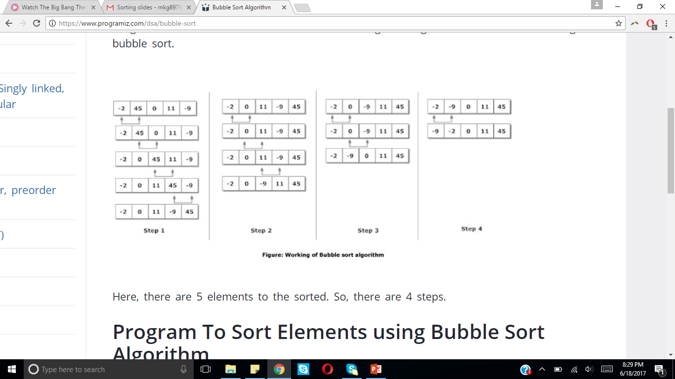
Bubble Sort Working

Slide 29
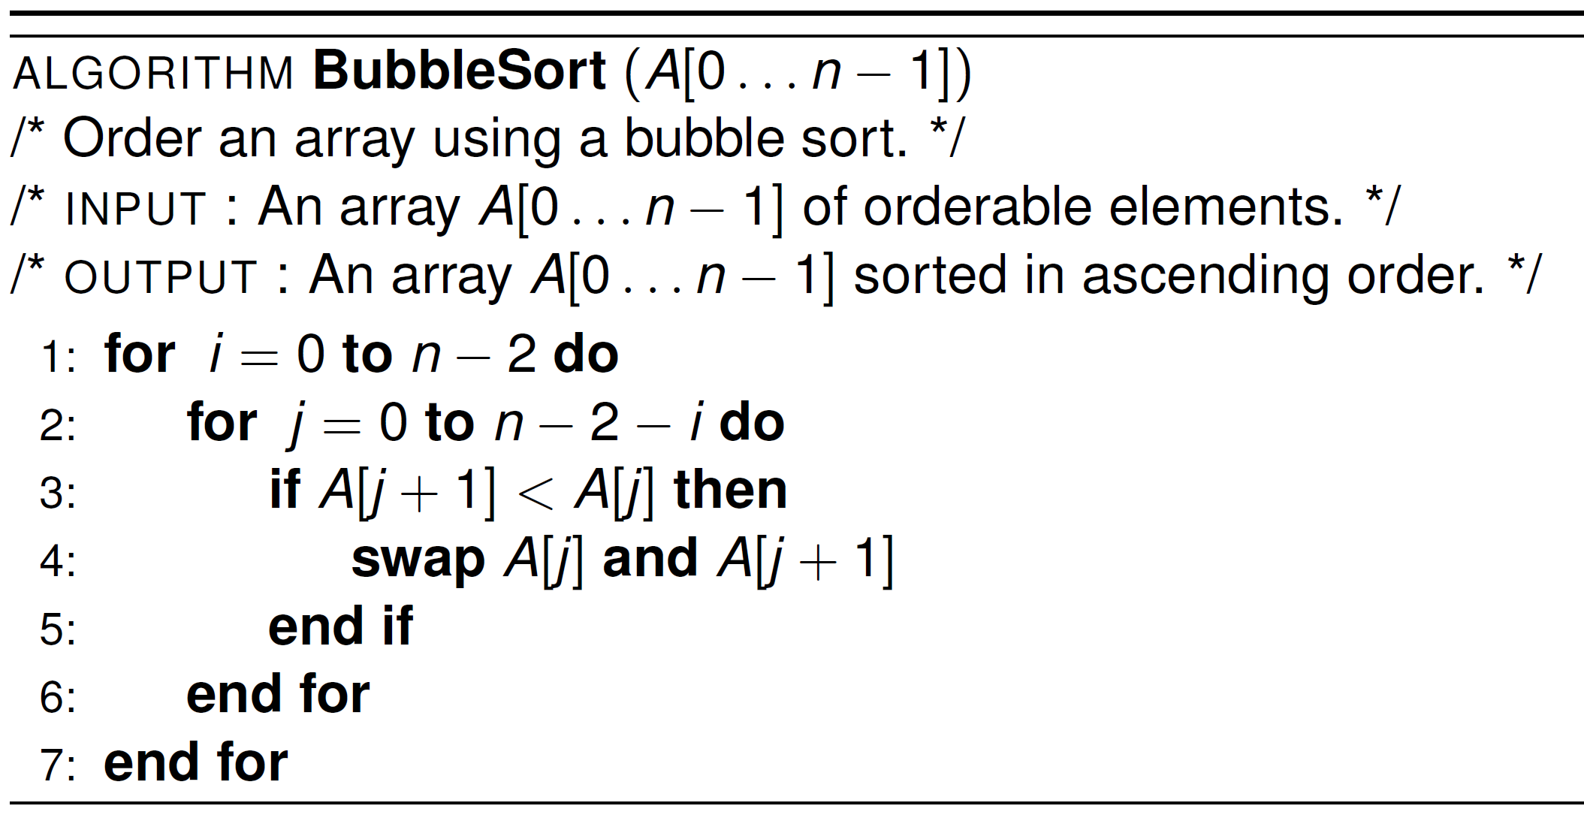
Bubble Sort – Pseudocode
Traverse to 2nd last element only
Keep traversing and swapping but leave the sorted part alone

Slide 30
Bubble Sort – Demo
https://visualgo.net/bn/sorting

Slide 31
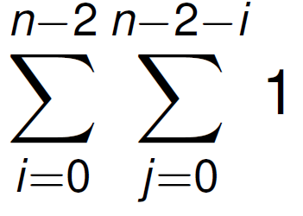
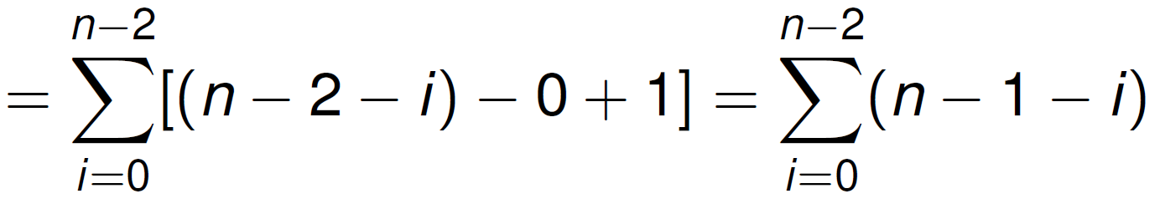
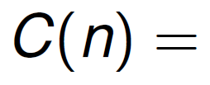
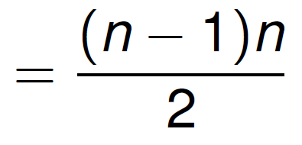
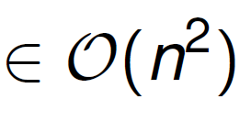
Bubble Sort – Time Complexity

Slide 32
Bubble Sort – Time Complexity
Best case: if original file is already sorted
about n²/2 comparisons & 0 exchanges – O(n²).
Worst case: if original file is sorted in reverse order
about n²/2 comparisons & n²/2 exchanges – O(n²).
Average case: if original file is in random order
about n²/2 comparisons & less than n²/2 exchanges – O(n²).
Is bubble sort stable?

Slide 33
Improved Bubble Sort
This modification attempts to reduce redundant iterations, by checking if any exchanges takes place in each pass.
If there were no exchanges in the current iteration, the sorting is stopped after the current iteration.
Early-Termination Bubble Sort

Slide 34
Improved Bubble Sort – Complexity
Best case - when the original file is already sorted, only one pass is needed, n − 1 comparisons, 0 exchanges – O(n).
Worst case - No improvement over the original implementation – O(n²).
Average case - Depending on the data set, few iterations can be eliminated at the end of the sort.
Therefore, the number of passes is less than n − 1, and hence cost is lower than the original implementation. The complexity is still likely to be O(n²).

Slide 35
3. Convex Hull and Exhaustive Search

Slide 36
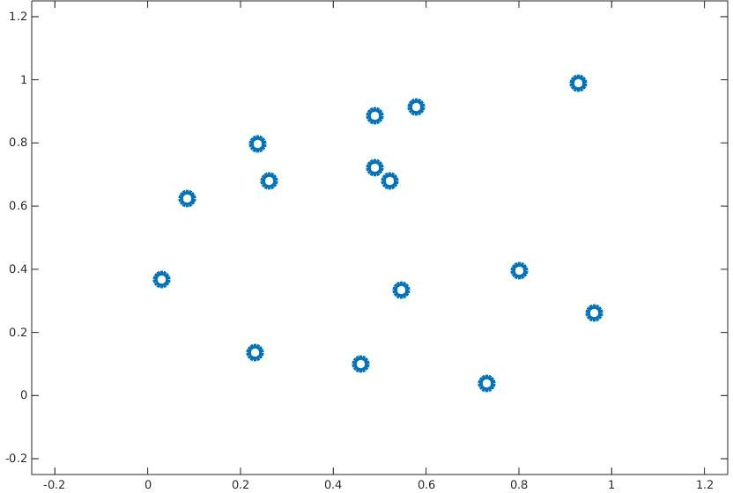
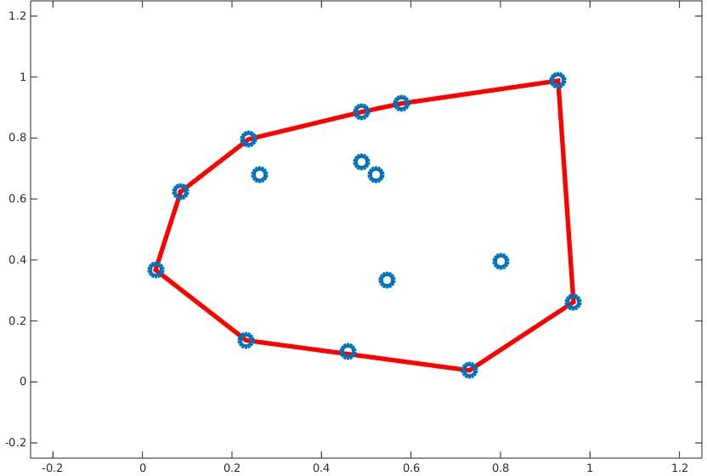
Convex hull problem
The convex hull of a set of points is the smallest convex polygon that contains all the points, i.e., all the points are “within” the polygon.
Points
Convex hull
Notes:
Hull means body

Slide 37
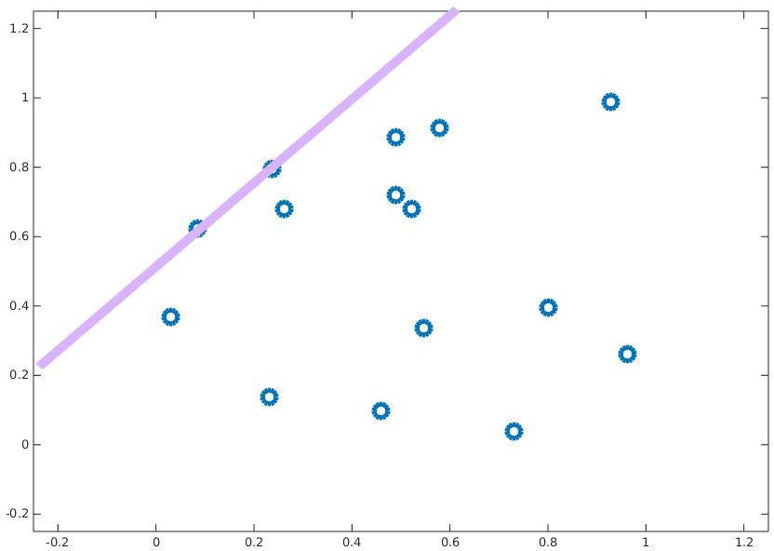
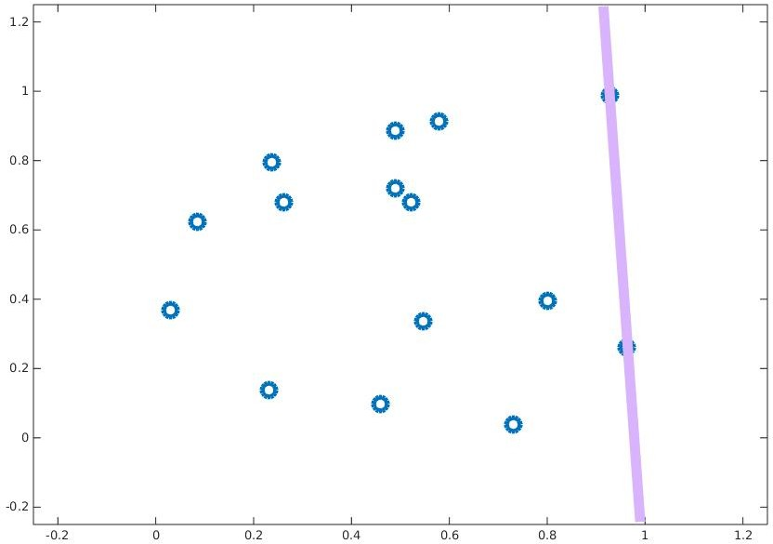
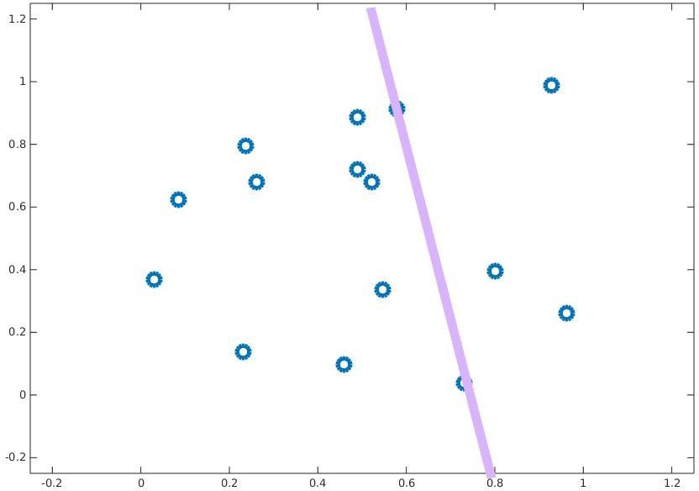
A Brute Force solution for Convex Hull problem
Idea: If we can identify all the line segments/adjacent pairs of points that form the boundary of the convex hull, then we have the convex hull.
Part of hull
Part of hull
Not part of hull

Slide 38
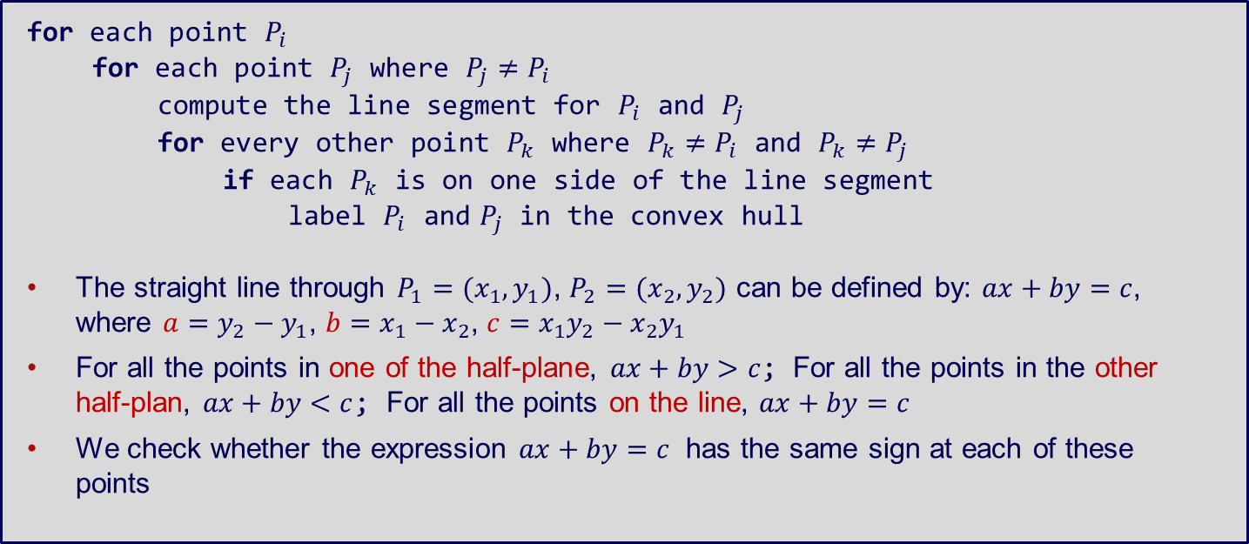
Brute Force Convex Hull - Pseudocode
for each point $P_{i}$
for each point $P_{j}$ where $P_{j}≠P_{i}$
compute the line segment for $P_{i}$ and $P_{j}$
for every other point $P_{k}$ where $P_{k}≠P_{i}$ and $P_{k}≠P_{j}$
if each $P_{k}$ is on one side of the line segment
label $P_{i}$ and $P_{j}$ in the convex hull
The straight line through $P_{1}=(x_{1},y_{1})$, $P_{2}=(x_{2},y_{2})$ can be defined by: $ax+by=c$, where $a=y_{2}−y_{1}$, $b=x_{1}−x_{2}$, $c=x_{1}y_{2}−x_{2}y_{1}$
For all the points in one of the half-plane, $ax+by>c$; For all the points in the other half-plan, $ax+by<c$; For all the points on the line, $ax+by=c$
We check whether the expression $ax+by=c$ has the same sign at each of these points

Slide 39
A Brute Force solution for Convex Hull problem
Complexity of algorithm: Since there are O(n²) pairs of points to examine, and each check requires going through O(n) remaining points, the algorithm is O(n³).
Part of hull
Part of hull
Not part of hull

Slide 40

Convex hull application
Video Game Collision Detection:
http://www.youtube.com/watch?v=zSQS3ypnJok

Slide 41
Another Brute Force solution…
Exhaustive Search
A brute force solution involving enumerating/generating all possible solutions, then selecting the “best” one.
Typically applied to combinatorial problems, and insightful to study brute force solutions to them, as some problems can only be solved optimally by exhaustive search.

Slide 42
Exhaustive Search – Idea
Generate a list of all potential solutions to the problem in a systematic manner.
Evaluate potential solutions one by one, disqualifying infeasible ones, and keeping track of the best one found so far.
When all items have been evaluated, announce the best solution(s)found.

Slide 43
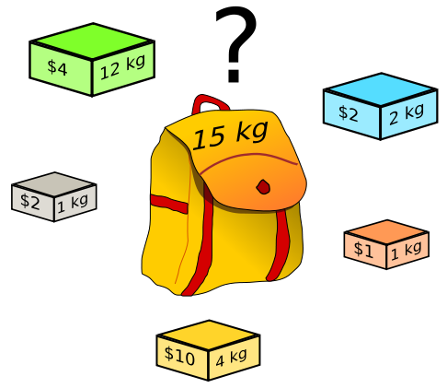
The Knapsack problem
Given n items of known weights w₁, … , w_{n} and the values v₁, … , v_{n} and a knapsack of capacity W , find the most valuable subset of the items that fit into the knapsack

Slide 44


Applications of Knapsack Problem

Slide 45
Knapsack Brute Force algorithm
Consider all subsets of the set of n items.
Compute the total weight of each subset in order to identify feasible subsets (the ones with the total not exceeding the knapsack’s capacity).
Find the subset of the largest value among them.
Complexity: Since the number of subsets of an n-element set is 2^{n}, an exhaustive search produces an O(2^{n}) algorithm.

Slide 46
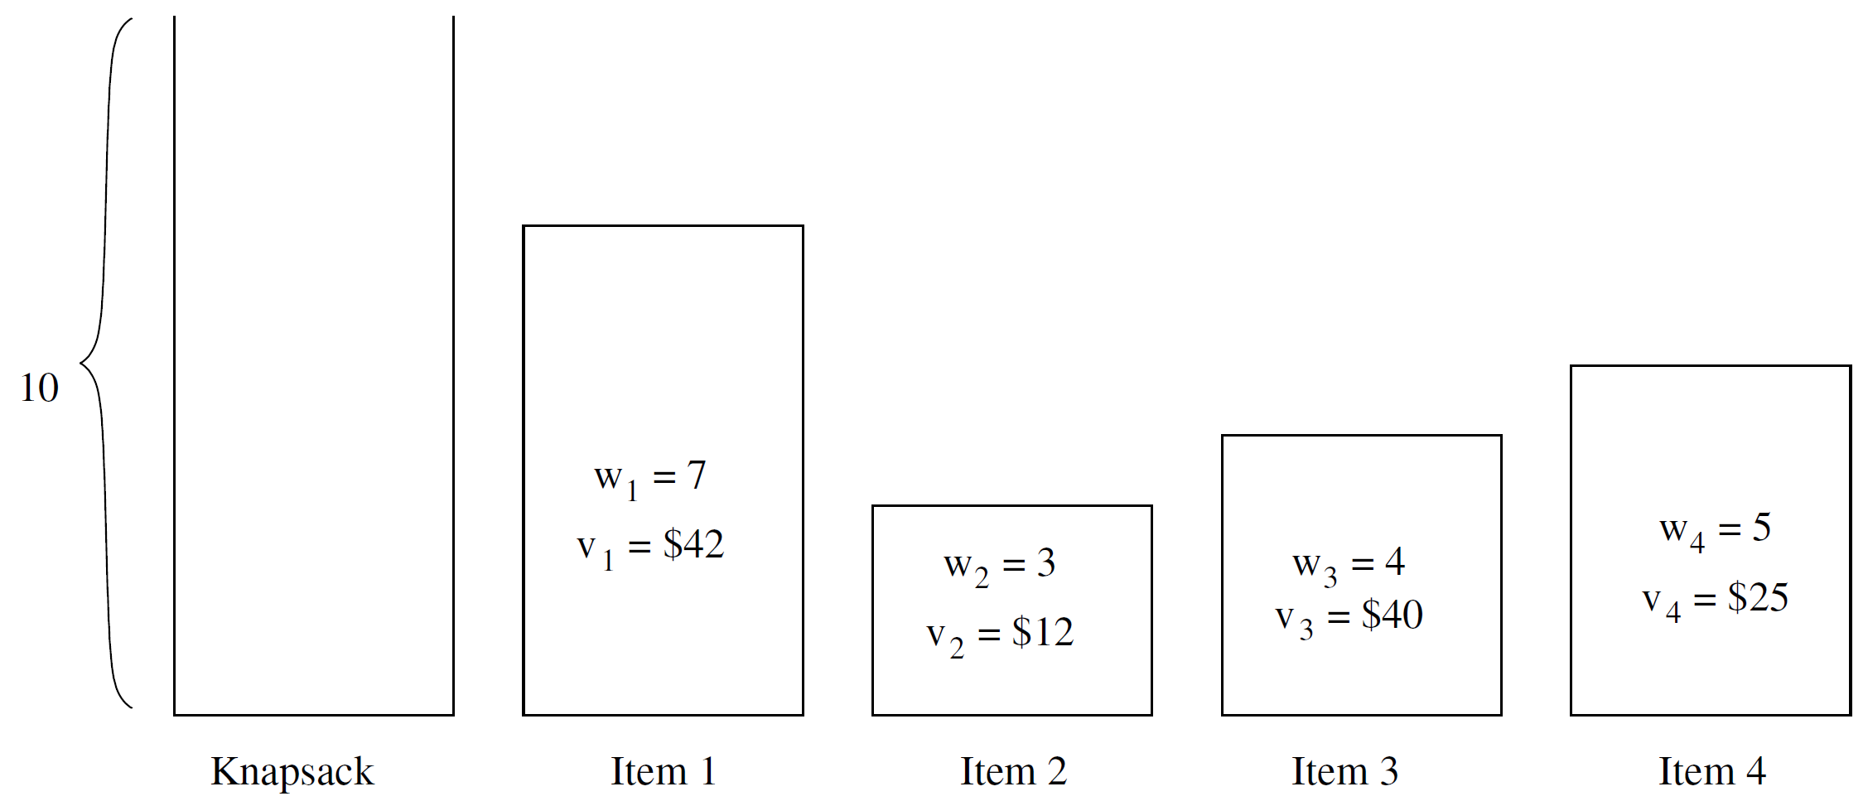
Knapsack problem

Slide 47
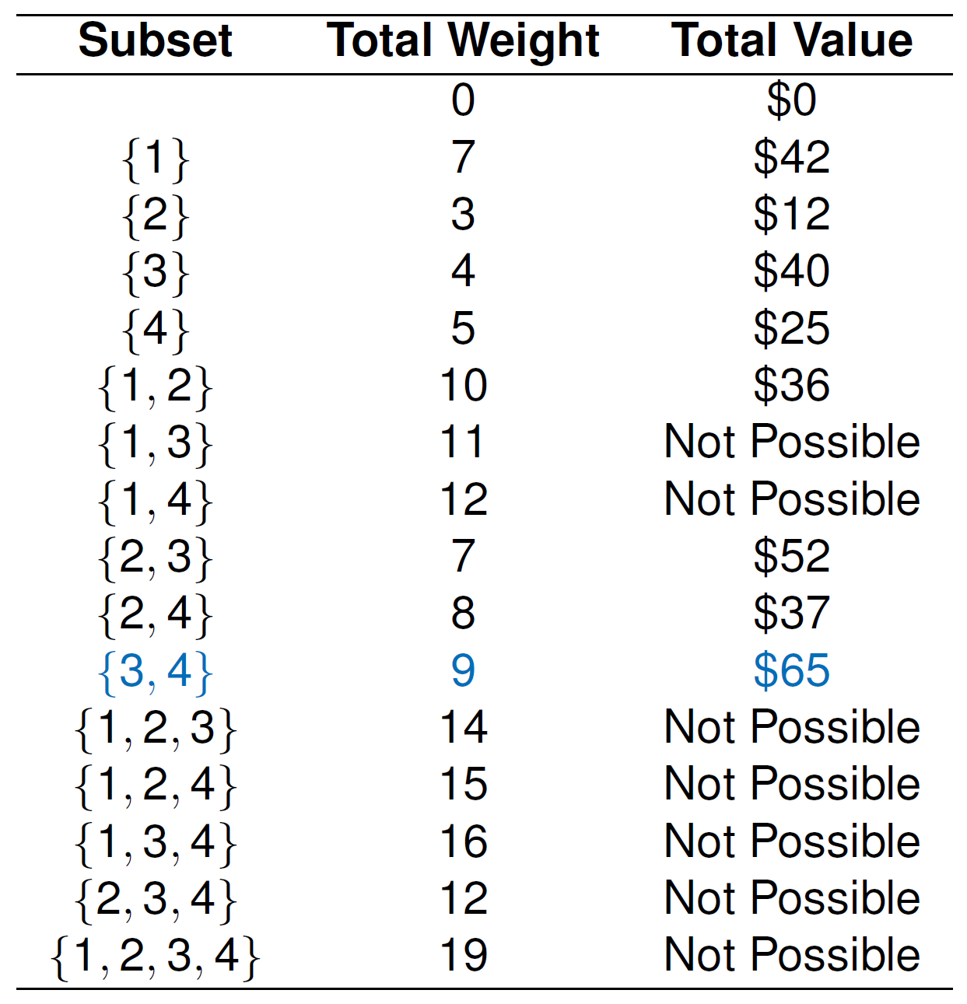
Knapsack problem – Solution

Slide 48
4. Extra Brute Force approaches

Slide 49
Sequential Search
Sequential search or linear search involves scanning each element of the entire collection sequentially until the key is found
Algorithm SequentialSearch(A[0…n],K)
i = 0;
while A[i] != K do
i = i + 1;
if i < n return i
else return -1

Slide 50
Sequential Search – Analysis
What if we have an ordered list?
We can early-terminate a sequential search too
Case | Best | Average | Worst
Item is present | 1 | n/2 | n
Item is not present | n | n | n
Notes:
Best = 1; Worst = n; Average = n/2 for both cases

Slide 51
String Matching
Given a string of n characters called the text and a string of m characters (m<=n) called the pattern, find a substring of the text that matches the pattern.
For example:
“RMIT IS THE BEST UNIVERSITY” (text)
“UNIV” (pattern)

Slide 52
String Matching – Idea
Align the pattern against the first m characters of the text.
Start matching the corresponding pair of characters from left to right until either all the m pairs are match.
Or if the missing pair is found, the pattern is shifted one position to the right and character comparisons are resumed, starting again from the 1st character.

Slide 53
String Matching – Idea
RMIT IS THE BEST UNIVERSITY UNIV
RMIT IS THE BEST UNIVERSITY UNIV
RMIT IS THE BEST UNIVERSITY UNIV
RMIT IS THE BEST UNIVERSITY UNIV
…
RMIT IS THE BEST UNIVERSITY UNIV

Slide 54
String Matching – Pseudocode
Algorithm BruteForceStringMatch (T[0…n-1],P[0…m-1])
for i = 0 to n-m
j = 0
while j < m and P[j] = T[i+j] do
j = j + 1
if i = m return i
return -1

Slide 55
String Matching – Analysis
Worst case: The algorithm may have to make all m comparisons before shifting the pattern, and this can happen for each of the n-m+1 tries, i.e., m(n-m+1). Therefore the worst case is O(nm).
For example:
Text = AAA…AAAAH
Pattern = AAAAH

Slide 56
String Matching – Analysis
Average Case: O(n+m) = O(n).
Best Case: O(m) (if m is found in first place–m comparisons are needed), or O(n) (if m is not found–check n times)
For example:
Text = AAA…AAAAH
Pattern = AAA or BBB

Slide 57
Stock Buy Sell to Maximize Profit
The cost of a stock on each day is given in an array, find the max profit that you can make by buying and selling in those days. For example, if the given array is {100, 180, 260, 310, 40, 535, 695}, the maximum profit can earned by buying on day 0, selling on day 3. Again buy on day 4 and sell on day 6. If the given array of prices is sorted in decreasing order, then profit cannot be earned at all.
Find the local minima and store it as starting index. If not exists, return.
Find the local maxima. and store it as ending index. If we reach the end, set the end as ending index.
Update the solution (Increment count of buy sell pairs)
Repeat the above steps if end is not reached.

Slide 58
Buy 1 Sell 1 to Maximize Profit
Find maximum difference between two items in an array where the Two loop solution - ((n**2)
int maxDiff(int arr[], int arr_size)
{
int max_diff = arr[1] - arr[0];
for (int i = 0; i < arr_size; i++)
{
for (int j = i+1; j < arr_size; j++)
{
if (arr[j] - arr[i] > max_diff)
max_diff = arr[j] - arr[i];
}
}
return max_diff;
}

Slide 59
Buy 1 Sell 1 to Maximize Profit
int maxDiff(int arr[], int arr_size)
{
// Maximum difference found so far
int max_diff = arr[1] - arr[0];
// Minimum number visited so far
int min_element = arr[0];
for(int i = 1; i < arr_size; i++)
{
if (arr[i] - min_element > max_diff)
max_diff = arr[i] - min_element;
if (arr[i] < min_element)
min_element = arr[i];
}
return max_diff;
}
Keep Track of
Maximum difference found so far (max_diff)
Minimum number visited so far (min_element)
Solution in O(n) time and O(1) space

Slide 60
Other Examples
Rotate an array by K positions in O(n) time and O(1) space
Remove a loop in a linked list
Describe an O(n) time and O(1) space algorithm that converts a given list into a jagged list. a Jagged list is a list where the values go up and down as we traverse the list, e.g. Original list: 4, 3, 7, 8, 6, 2, 1 and a Jagged list: 3, 7, 4, 8, 2, 6, 1 (as 3 < 7 > 4 < 8 >2 <6 >1).
A sorted array (A) of length N is populated with N consecutive different integers ranging from 0 to N with one number always missing. For example, if N=7 and the array = [0, 1, 2, 3, 4, 6, 7] then the missing value is 5 or if the array = [1, 2, 3, 4, 5, 6, 7] then the missing value is 0, find an O(log n) algorithm

Slide 61
To finish…

Slide 62
Learning objectives
Understand the Brute Force approach
Understand and apply:
Sorting – Selection and Bubble Sorts
Computational geometry – Convex hull problems
Searching – Exhaustive Search and Sequential Search
String Matching – Brute Force approach

